Slide 1
Weekly report: Rotor Blade Aerodynamics
Week number: 07
Date: 11.11.2025
Supervisor: Prof. Dr. rer.nat. Alois Schaffarczyk
Team Members: Jay Pandya, Kandarp Pathak, Harsh Panchal, Daniyal Sikander
11.11.2025
1
Jay Pandya
Rotor Blade Aerodynamics/ Optimus Syria

Slide 2
List of contents
KSS code
Output of IEA Wind 15MW
Segmentation error
11.11.2025
Jay Pandya
Rotor Blade Aerodynamics/ Optimus Syria

Slide 3
KSS Code
KSS software is a computational tool that uses numerical methods and aerodynamic models—such as the Blade Element Momentum (BEM) theory and Computational Fluid Dynamics (CFD)—to analyze and optimize wind turbine rotor blade performance.
The software calculates key aerodynamic parameters such as lift, drag, power coefficient (Cp), thrust (CT), and torque, allowing engineers to evaluate and refine blade geometry for maximum efficiency and stability under varying wind conditions.
Its flexibility, open-source environment, and data visualization capabilities make KSS an essential platform for modern wind turbine aerodynamic design and research.
11.11.2025
Jay Pandya
Rotor Blade Aerodynamics/ Optimus Syria

Slide 4
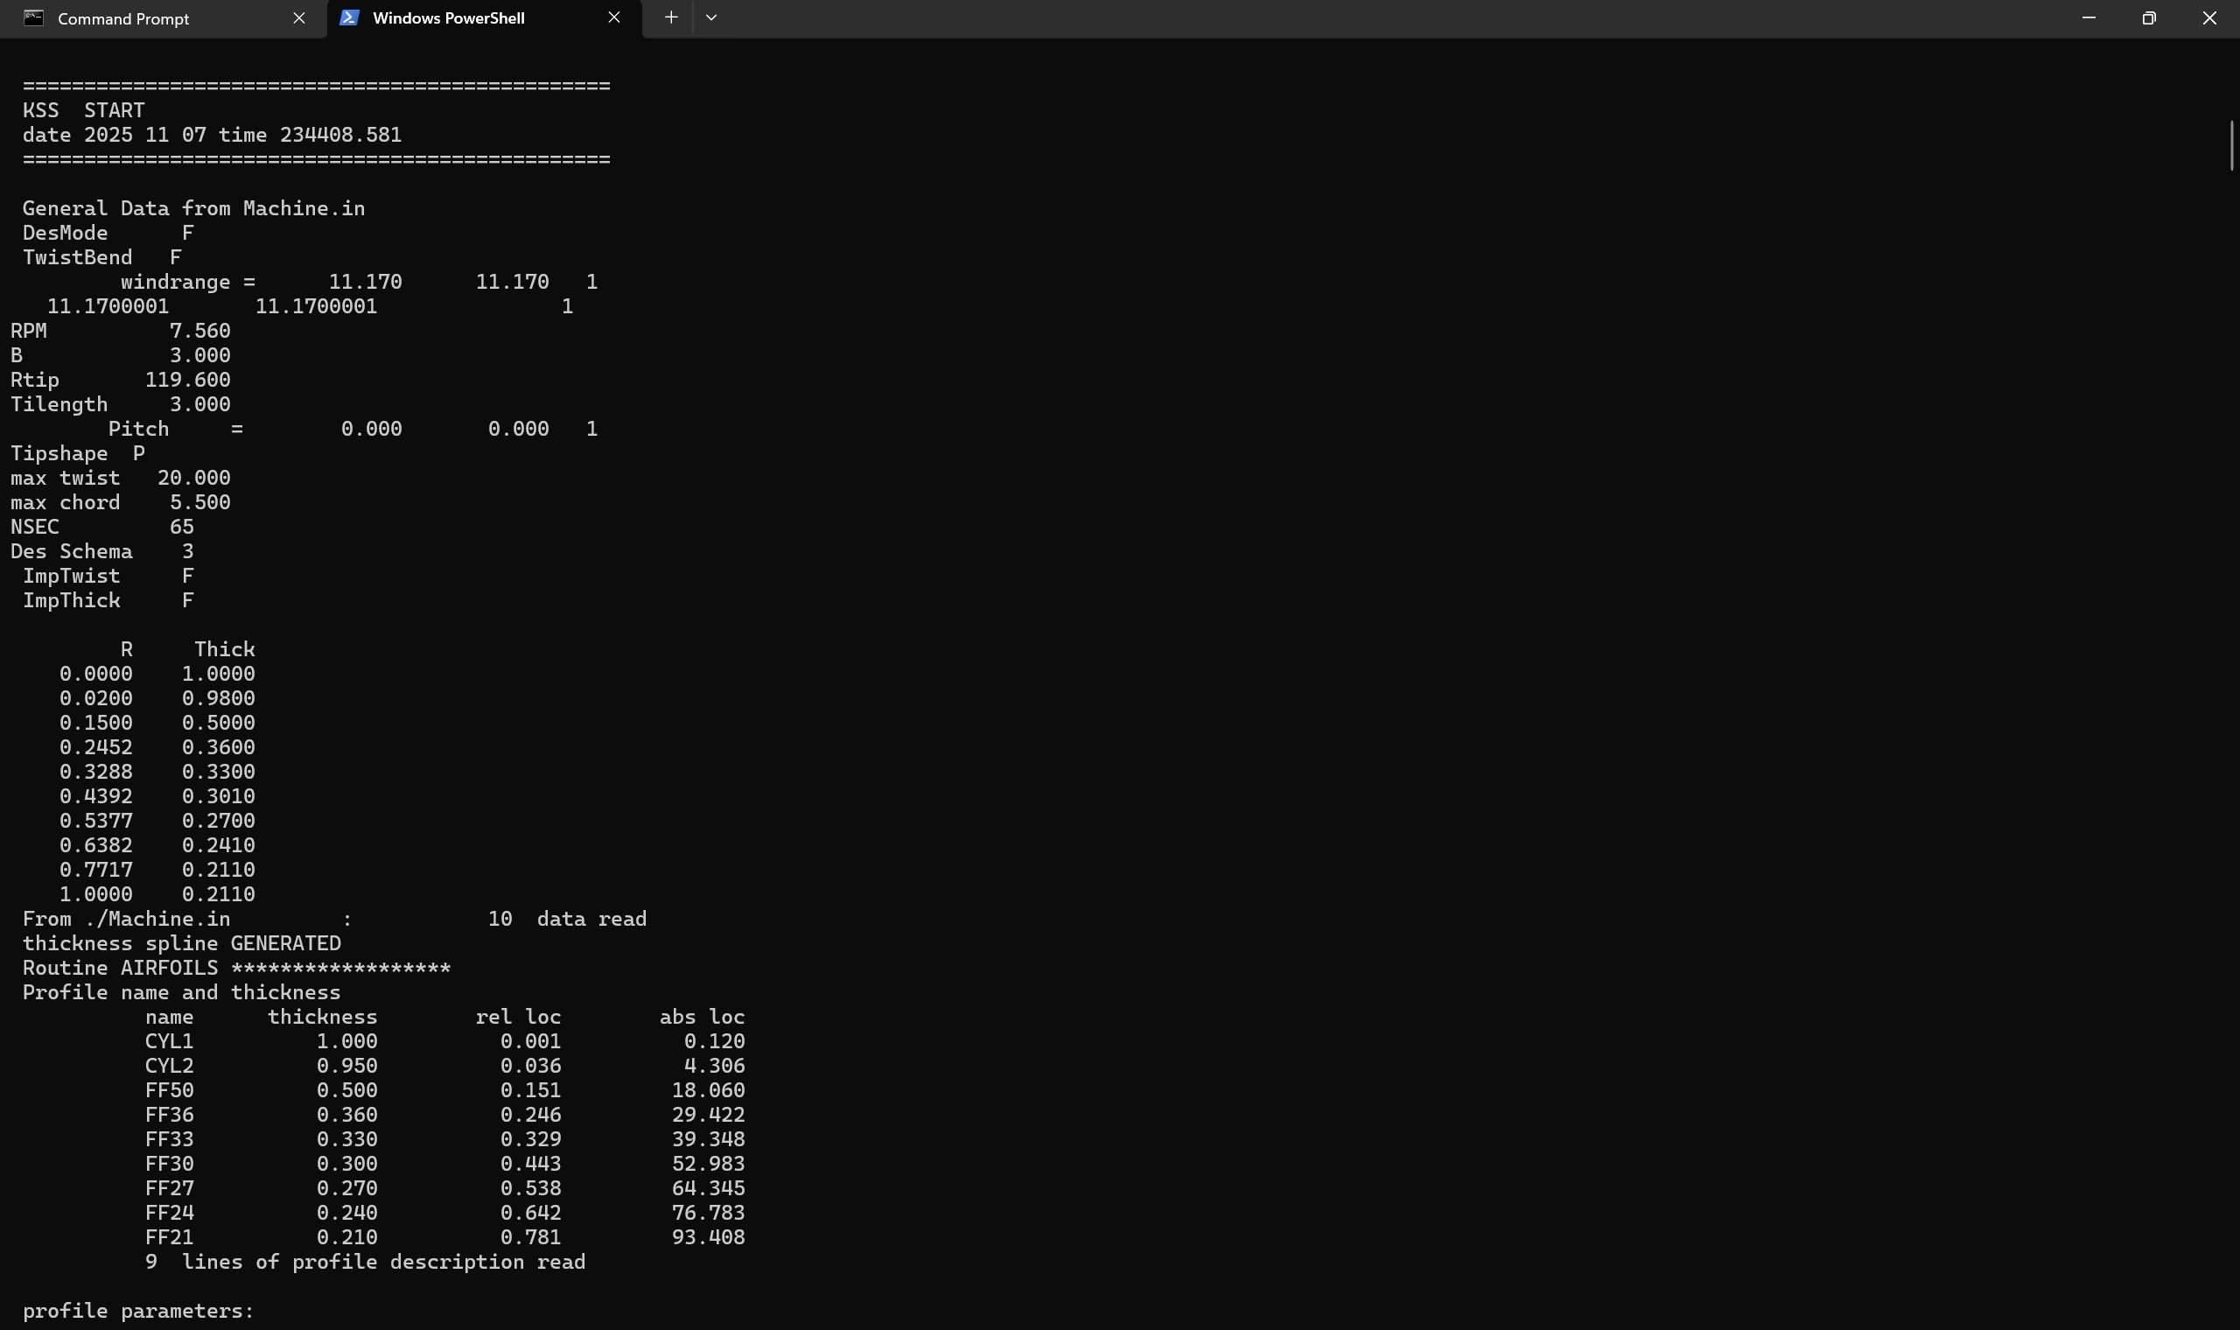
Output of IEA Wind 15MW
11.11.2025
Jay Pandya
Rotor Blade Aerodynamics/ Optimus Syria

Slide 5
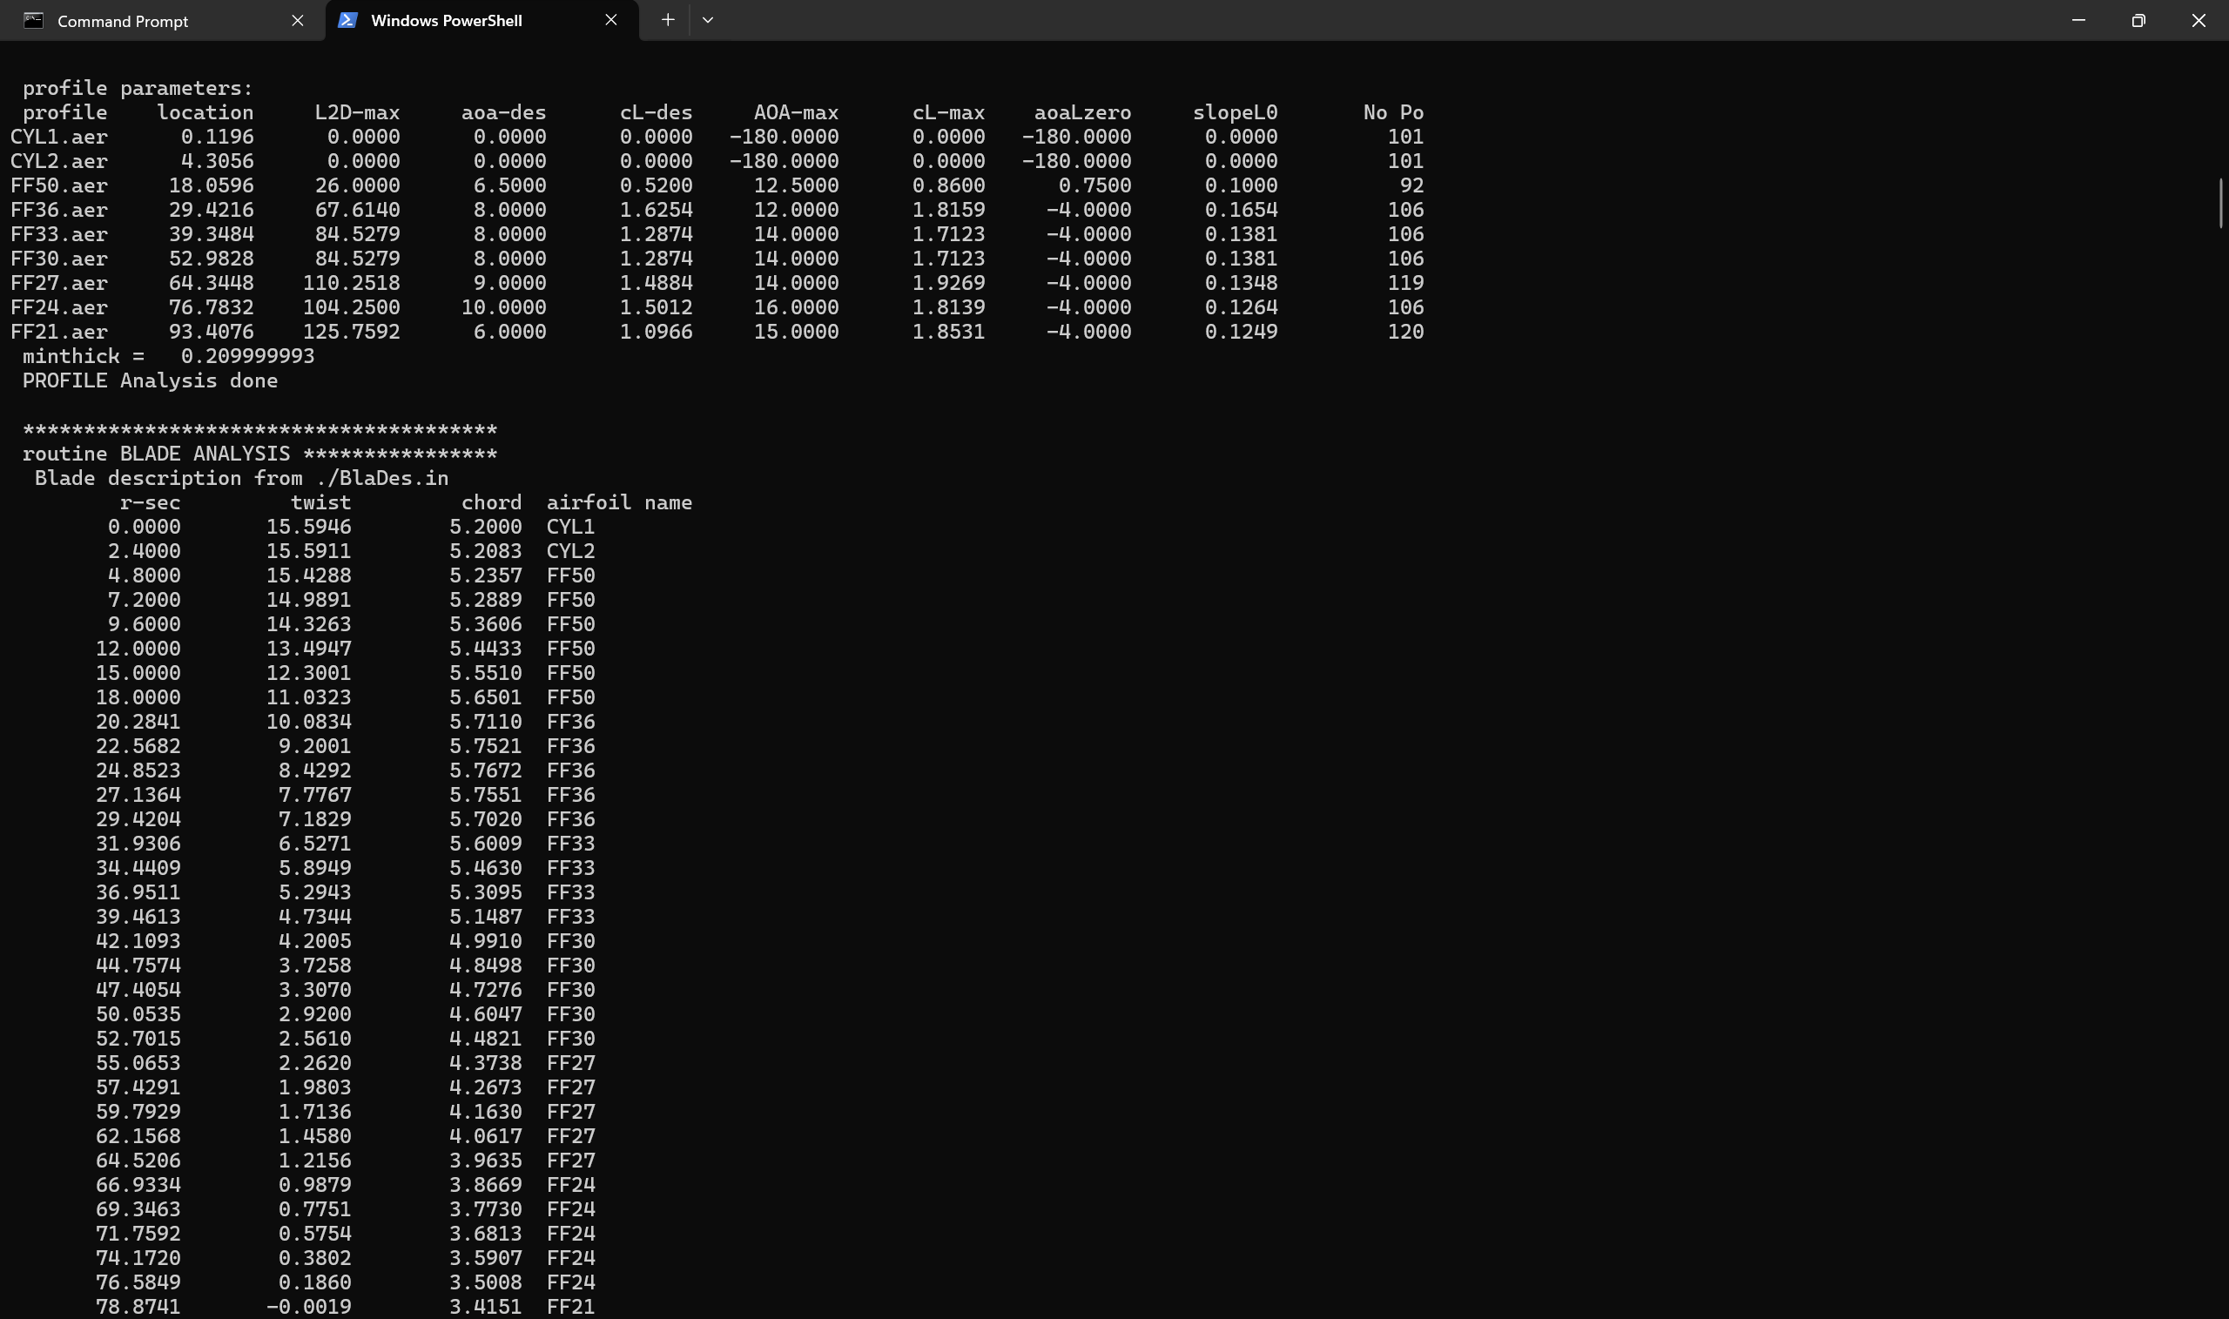
Output of IEA Wind 15MW
11.11.2025
Jay Pandya
Rotor Blade Aerodynamics/ Optimus Syria

Slide 6
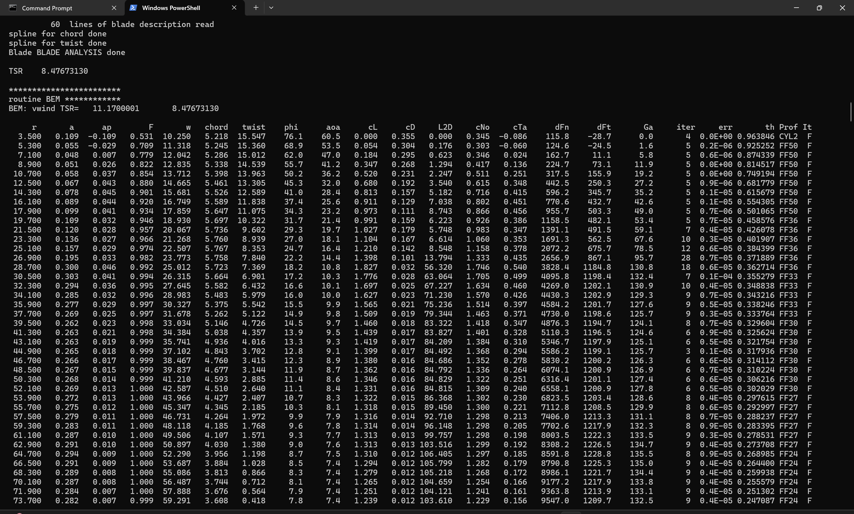
Output of IEA Wind 15MW
11.11.2025
Jay Pandya
Rotor Blade Aerodynamics/ Optimus Syria

Slide 7
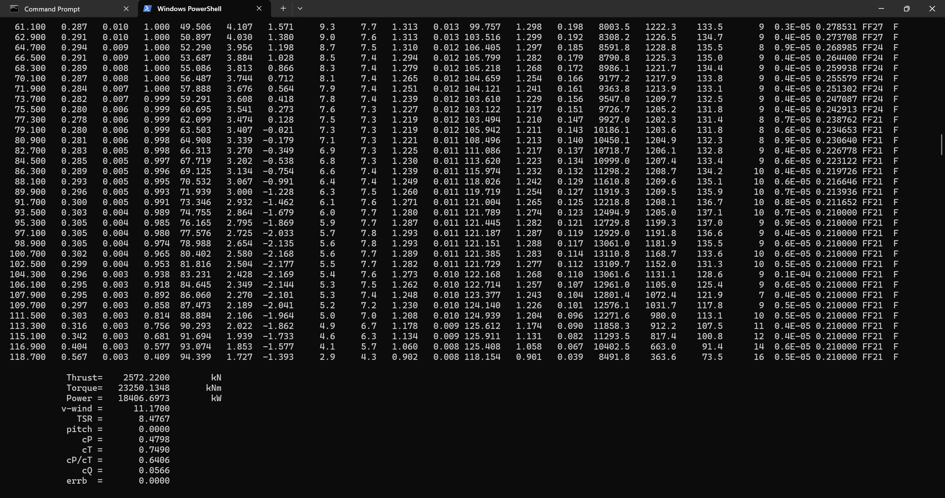
Output of IEA Wind 15MW
11.11.2025
Jay Pandya
Rotor Blade Aerodynamics/ Optimus Syria

Slide 8
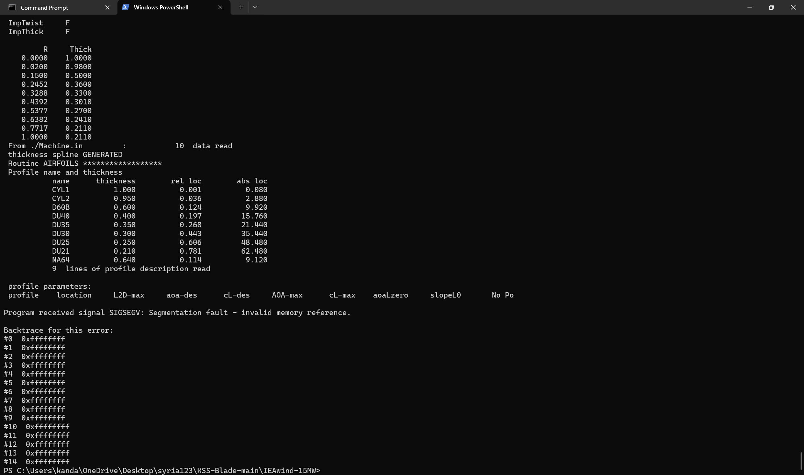
Segmentation Error
11.11.2025
Jay Pandya
Rotor Blade Aerodynamics/ Optimus Syria

Slide 9
Bibliography
Self Generated Content (09.11.2025)(13:45)
11.11.2025
Jay Pandya
Rotor Blade Aerodynamics/ Optimus Syria

